Slide 1
PROJECT TITLE
CAPSTONE PROJECT
Presented By: PUNYABHURAJ SURYAAWANSHI
Student Name : PUNYABHURAJ SURYAAWANSHI
College Name & Department : SAVITRIBAI PHULE PUNE UNIVERSITY

Slide 2
OUTLINE
Problem Statement
Technology used
Wow factor
End users
Result
Conclusion
Git-hub Link
Future scope

Slide 3
Problem Statement
This project seeks to advance the field of steganography by developing a robust technique that effectively conceals sensitive information within digital images while preserving their quality.
By addressing the limitations of traditional methods, such as low embedding capacity and vulnerability to detection, the proposed solution aims to achieve high levels of security and efficiency.
The focus on imperceptibility ensures that the hidden data remains undetectable to both casual observers and potential attackers.
Ultimately, this approach will contribute to safer data transmission, facilitating secure communication in an increasingly digital world.

Slide 4
Technology used
Programming Language :
Python – Used for building encryption and decryption logic.
Libraries :
OpenCV – Handles image processing and manipulation.
Platforms :
Runs on Windows, Linux and macOS with python installed.

Slide 5
Wow factors
This code implements a basic steganography technique using an XOR-based encryption method to hide text within the pixel values of an image.
A unique feature is its use of a user-defined security key to encrypt and subsequently decrypt the hidden message, ensuring that only someone with the correct key can access the concealed information.
The program reads an image, replaces pixel values with those derived from the text and the key, and maintains the colour balance by cycling through the RGB channels.
Additionally, it features error handling for key mismatches, enhancing the security of the hidden data. After embedding, the modified image is saved and opened automatically for immediate access.

Slide 6
End users
Privacy-Conscious Individuals: Users who want to securely share sensitive information (such as personal messages or keys) without alerting others that data is being transmitted.
Digital Artists: Creators who might want to embed a personal signature or message within their artwork or digital images without altering the visible appearance.
Information Security Professionals: Experts who need to test the resilience of digital images against steganalysis attacks, exploring vulnerabilities in traditional image formats.
Data Scientists: Researchers who may utilize steganography techniques for secure data annotation or hidden data storage in image datasets.
Whistleblowers: Individuals in sensitive positions needing to share information securely while maintaining anonymity.
Students and Educators: Those learning about steganography and encryption, using this code as a practical example to understand data hiding techniques and security principles.

Slide 7
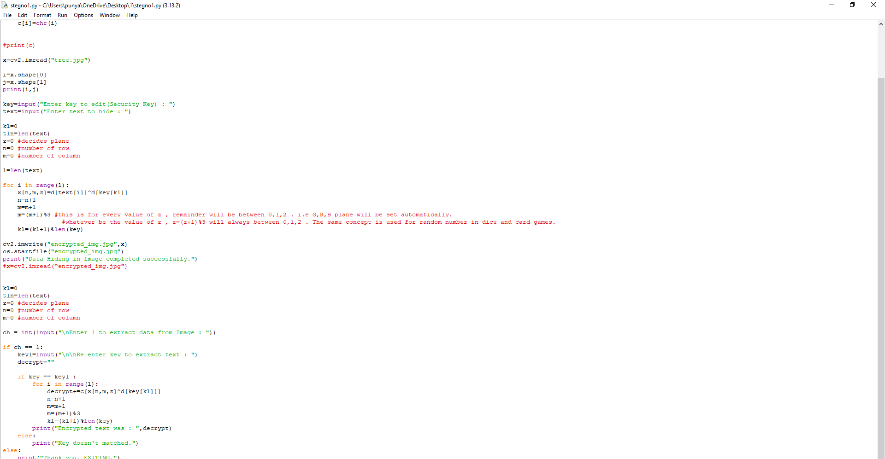
Results Stegno1.py

Slide 8
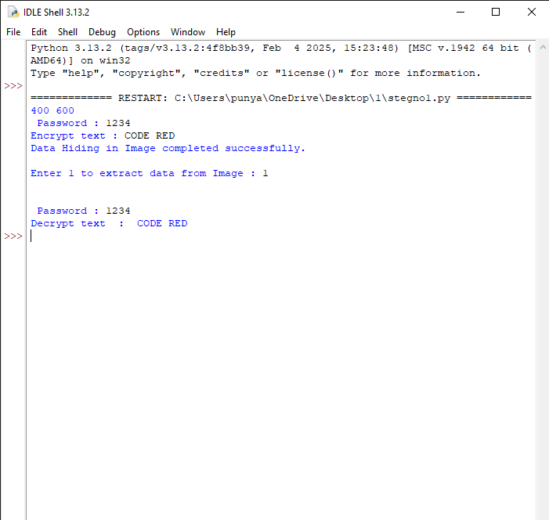
ENCRYPTED AND DECRPTED TEXT

Slide 9

Encrypted image

Slide 10
Conclusion
This Python code implements a simple steganography technique using the OpenCV library to conceal a text message within the RGB channels of an image. It reads an image ("tree.jpg") and allows the user to input a security key and the text to hide. The message is embedded by applying an XOR operation between the text characters and the key, modifying the pixel values of the image. Once the image is saved as "encrypted_img.jpg," the user has the option to extract the hidden message by providing the same key. If the keys match, the original text is revealed; otherwise, an error message is displayed. This program demonstrates basic principles of data hiding and image modification.

Slide 11
GitHub Link
https://github.com/Punyabhuarj/Secure-Data-Hiding-In-Images-Steganography.git

Slide 12
Future scope(optional)
Advanced Encryption Algorithms: Incorporate more sophisticated encryption algorithms (e.g., AES, RSA) to enhance security beyond simple XOR operations, making hidden messages more resilient against detection.
Multi-Layered Steganography: Develop a framework that allows for hiding multiple messages or different types of data simultaneously within the same image, potentially using various algorithms for each layer.
Cross-Platform Support: Create a user-friendly interface or application that functions across various platforms (Windows, macOS, mobile devices) to make the tool more accessible to a broader audience.
Integration with Other Media: Expand capabilities to include other media formats (audio, video) for concealing information, allowing users to hide messages in a variety of digital content.
Detection and Forensics: Research into methods for detecting hidden messages, potentially creating tools for digital forensics experts to identify and extract steganographic data from suspicious files.

Slide 13
THANK YOU

